Slide 1



Healthcare Data Analysis
Group: CAI3_DAT1_G3
01
WWW.REALLYGREATSITE.COM

Slide 2

prepared by
SARAH ALI MANSY
BISHOY NASSER MOSAAD YASSA
EMAN RABEA MOHAMED
MENNA HATEM MUSTAFA IBRAHIM
SOMAIA AHMED ABDEL ZAHER ALI
MOHAMED ASHRAF MAHMOUD HASAN
02

Slide 3



Agenda
Project Overview
Project objective
Dataset Description:
Tools of Analysis
Data Cleaning (Power Query)
EDA Using Python
Data Modeling (Power BI)
Add Necessary DAX Measure
Dashboard Design
Insights and Recommendations
03

Slide 4

Project objective
Healthcare Data Analysis and Insights from Multisource Medical Records
Integrate multiple healthcare datasets into a unified model, ensuring data quality and consistency.
Perform exploratory analysis to uncover patterns in demographics, costs, and insurance coverage.
Design a star-schema model and define KPIs for encounters, procedure costs, and claims.
Develop an interactive Power BI dashboard to provide actionable insights for better decision-making.
04

Slide 5
DAtaset
Descritpion
Encounters
Tracks each patient visit with fields for: ID, start/stop time, patient, organization, payer, encounter type, clinical code description, base cost, total claim cost, and payer coverage.
Payers
Holds insurer details: payer ID, name, address, city, headquartered state, ZIP code, and phone contact — used for claims and coverage linkage.
Procedures
Captures medical procedures:
start/stop time, patient ID, encounter ID, clinical code description, and base cost of the procedure.
Patients
Includes demographic and identity details: patient ID, birth/death dates, name components, marital status, race, ethnicity, gender, birthplace, full address, and geolocation (lat/lon).
Organizations
Contains facility information: organization ID, name, address, city, state, ZIP code, and optional location coordinates (lat/lon).

Slide 6

Tools for
Data Analysis
Power Query
Python
Power BI
Data Modeling
Add Necessary DAX Measures
Dashboard Design
Data Cleaning
EDA
06

Slide 7
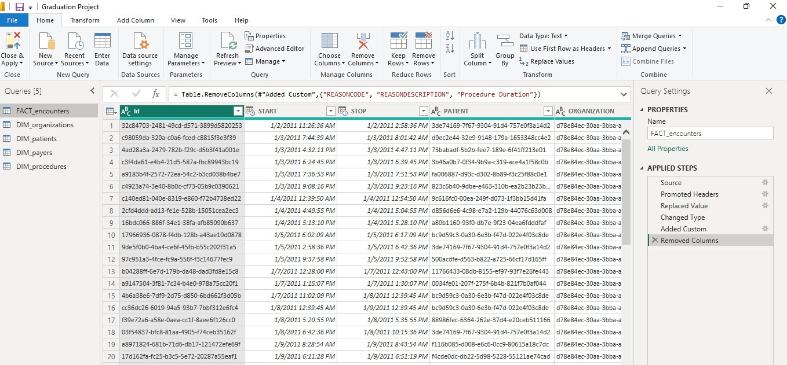
Tools of Analysis
1- Data Cleaning (Power Query)
Removing nulls, duplicates, errors - Deleting unnecessary columns
Editing dates and formatting - Deleting missing data
05

Slide 8
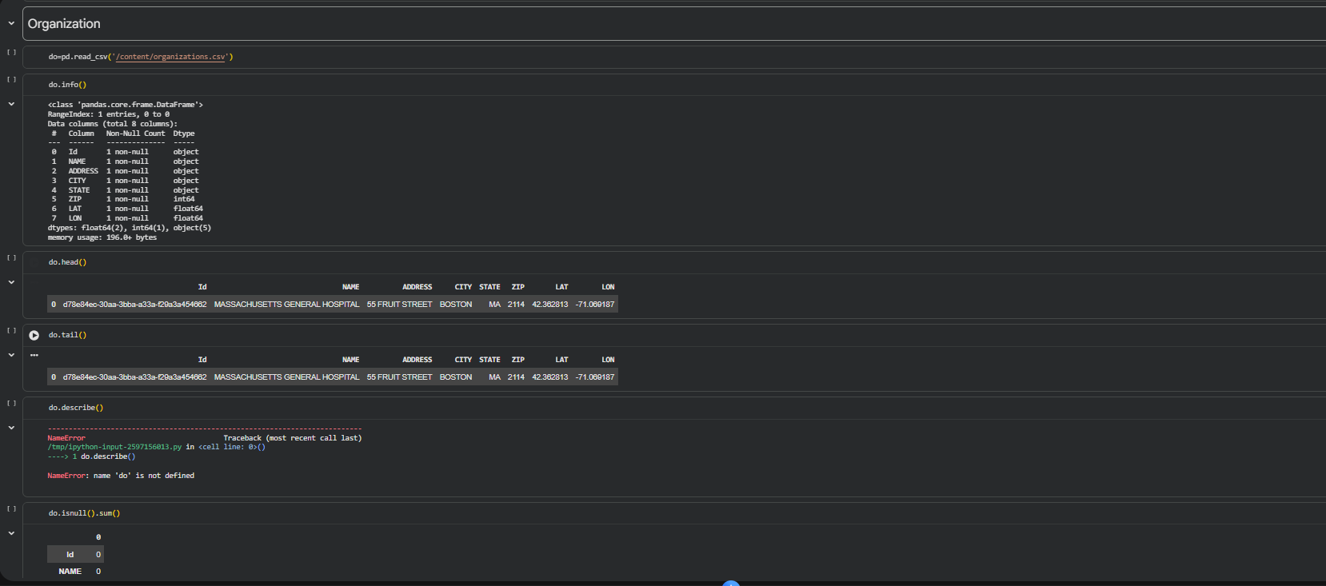
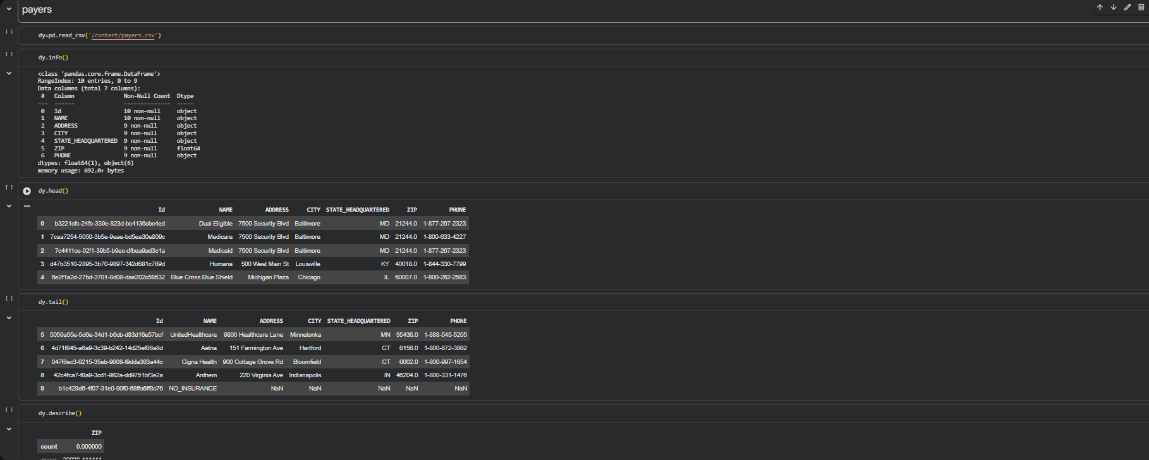
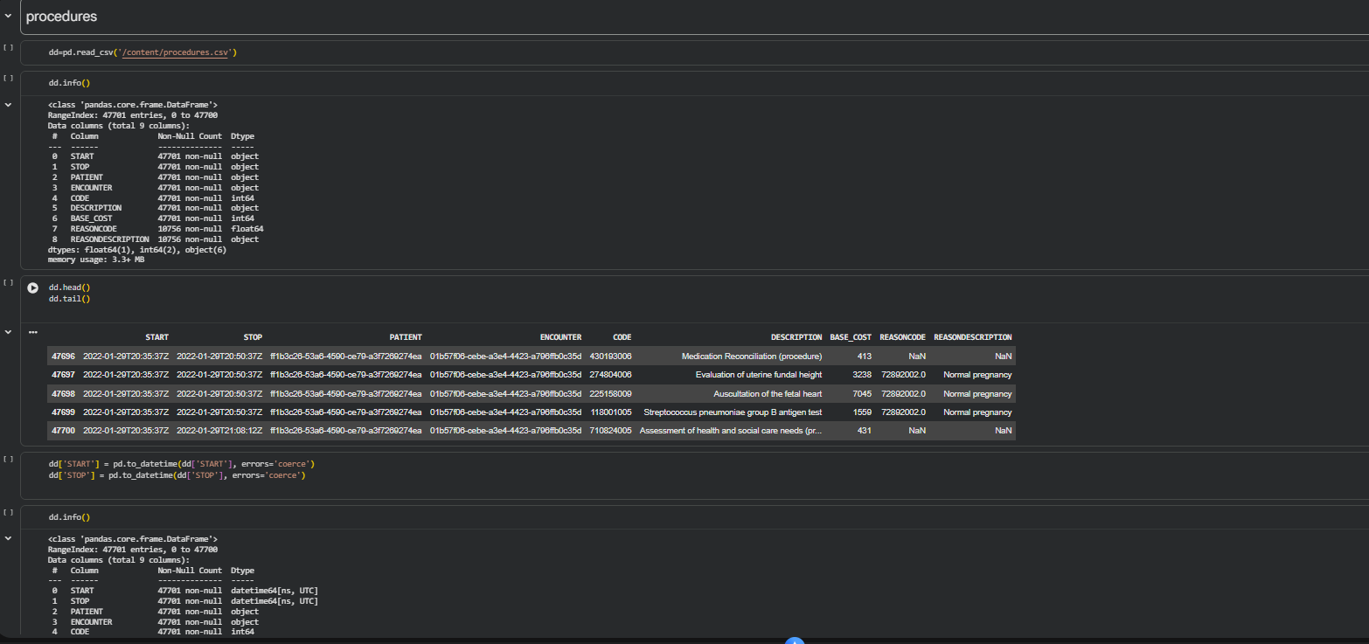
Tools of Analysis (Continued.)
2-Exploratory Data Analysis (EDA) (Python)
05

Slide 9
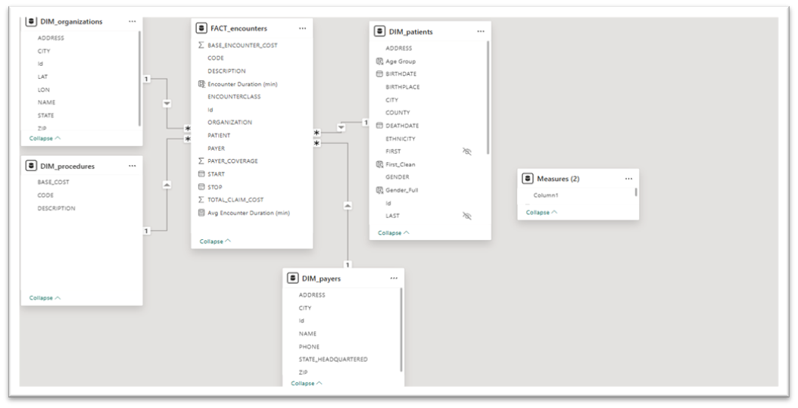

Tools of Analysis(Continued.)
3- Data Modeling (Power BI)
07

Slide 10

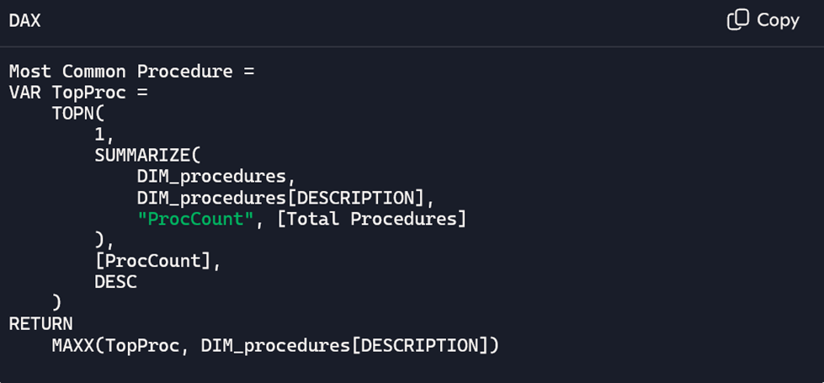
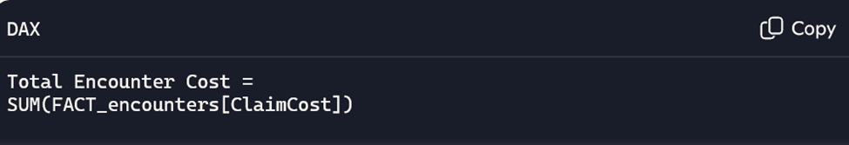
Tools of Analysis(Continued.)
4-Add Necessary DAX Measures
09

Slide 11
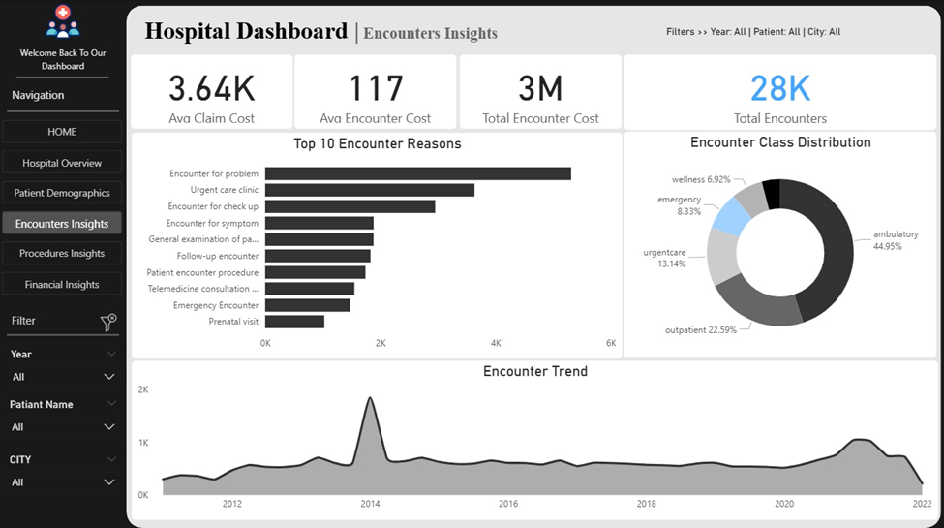
Tools of Analysis(Continued.)
5-Dashboard Design
10

Slide 12

Insights & Recommendations
Patient Volume & Behavior
The hospital served 974 patients, yet recorded 28K encounters, indicating a population with chronic conditions requiring continuous follow-up.
A notable surge in encounters occurred in 2014, likely linked to a health event or disease outbreak, which temporarily increased service demand.
Cost Drivers
Total claim cost reached $102M, driven primarily by high-acuity and resource-intensive services.
ICU admission, costing nearly $200K per procedure, is the largest single contributor to overall expenses, reflecting the presence of complex and severe cases.
Service Utilization
Most encounters fall under ambulatory and outpatient care, indicating that the hospital operates mainly as a clinic-focused and non-inpatient service provider.
Inpatient visits are minimal, suggesting fewer overnight admissions and a lower burden on inpatient resources.
11

Slide 13

Insights & Recommendations
Patient Demographics
Gender distribution is balanced (51% male, 49% female), showing neutral patient inflow across genders.
With an average age of 73, the patient population is predominantly elderly, explaining the high encounter frequency and elevated cost of care.
The majority race group is White, consistent with the demographic profile of Massachusetts, where the hospital operates.
Medical Reasons & Procedure Trends
The most common encounter reason is hospital admission, supporting the conclusion that many patients suffer from ongoing or chronic medical issues. Trauma-related and allergy-related encounters occur far less frequently, indicating these are not major service drivers within the hospital.
12

Slide 14
thank
you!
DATA ANALYSIS IS KEY TO THE GROWTH AND SUCCESS OF THE HEALTH SECTOR.
15

